Slide 1
Euler and Hamilton Paths
Course Code: 00090
Course Title: Discrete Mathematics
Dept. of Computer Science
Faculty of Science and Technology
Lecturer No: | 18 | Week No: | 10 | Semester:
Lecturer: | Name & email

Slide 2
Lecture Outline
8.5 Euler and Hamilton Paths
Euler Paths & Circuits (Edge based)
Hamilton Paths & Circuits (Vertex based)

Slide 3
Objectives and Outcomes
Objectives: To understand terms Euler path, Euler circuit, Hamilton path, Hamilton circuit; to determine whether a graph contains Euler or Hamilton path or circuit.
Outcomes: The students are expected to be able to explain the terms Euler path, Euler circuit, Hamilton path, Hamilton circuit with examples; be able to determine whether a given graph contains Euler or Hamilton path or circuit.

Slide 4
Euler paths and circuits
Euler path: An Euler path in G is a simple path containing every edge of G. An Euler path is a path that uses every edge of a graph exactly once. An Euler path starts and ends at different vertices.
Euler circuit: An Euler circuit in a graph G is a simple circuit containing every edge of G. An Euler circuit is a circuit that uses every edge of a graph exactly once. An Euler circuit starts and ends at the same vertex .

Slide 5
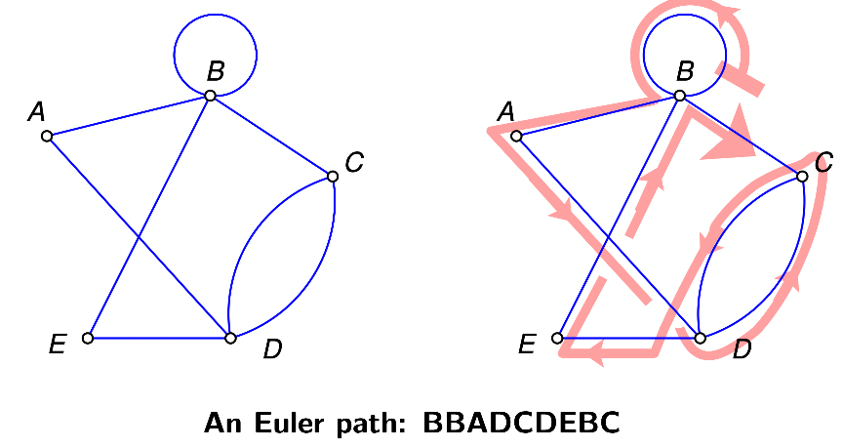
Euler paths and circuits

Slide 6
Euler paths and circuits
Theorem 1: A connected multigraph with at least two vertices has an Euler circuit iff each of its vertices has even degree.
Theorem 2: A connected multigraph has an Euler path (but not an Euler circuit) iff it has exactly two vertices of odd degree.

Slide 7
Euler paths and circuits
A graph contains Euler circuit if all of its vertices have even degree.
A graph contains Euler path if exactly two of it’s vertices have odd degree. End points of the Euler path are the two vertices with odd degree.
A graph does NOT contain any Euler path or Euler circuit if the graph contains more than two vertices of odd degree.
Euler circuit and Euler path are mutual exclusive (i.e., if a graph contains Euler circuit, it does not contain Euler path ; if a graph contains Euler path, it does not contain Euler circuit).

Slide 8
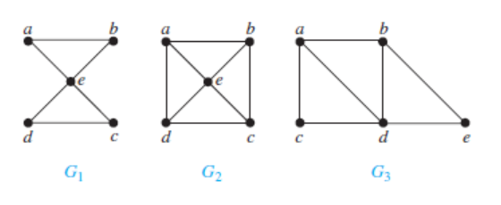
Euler paths and circuits
EXAMPLE 1 (p.572): Which of the undirected graphs in Figure below have an Euler circuit? Of those that do not, which have an Euler path?

Slide 9
Euler paths and circuits
Solution:
The graph G1 has an Euler circuit, for example, a, e, c, d, e, b, a.
Neither of the graphs G2 or G3 has an Euler circuit.
However, G3 has an Euler path, namely, a, c, d, e, b, d, a, b. G2 does not have an Euler path.

Slide 10
Determining Euler Circuit/Path in Direction Graph
How to check if a directed graph is Eulerian?
A directed graph has an Eulerian cycle if following conditions are true
1) All vertices with nonzero degree belong to a single strongly connected component
2) In degree is equal to the out degree for every vertex.

Slide 11
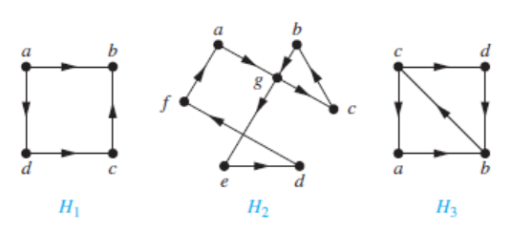
Determining Euler Circuit/Path: Example
EXAMPLE 2 (p.572): Which of the directed graphs in Figure 4 have an Euler circuit? Of those that do not, which have an Euler path?
Figure 4

Slide 12
Determining Euler Circuit/Path: Example
Solution:
The graph H₂ has an Euler circuit, for example,
a, g, c, b, g, e, d, f, a.
Neither H₁nor H₃ has an Euler circuit
H₃ has an Euler path, namely, c, a, b, c, d, b,
but H₁ does not have Euler path

Slide 13
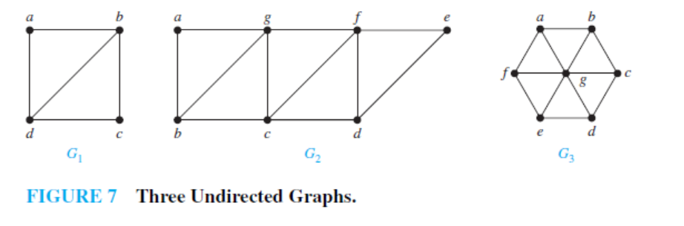
Determining Euler Circuit/Path: Example
Example 4(p.575):Which graphs shown in Figure 7 have an Euler path?

Slide 14
Determining Euler Circuit/Path: Example
Solution:
G₁ contains exactly two vertices of odd degree, namely, b and d. Hence, it has an Euler path that must have b and d as its endpoints.
  One such Euler path is d, a, b, c, d, b.
Similarly,G₂ has exactly two vertices of odd degree, namely, b and d. So it has an Euler path that must have b and d as endpoints.
  One such Euler path is b, a, g, f, e, d, c, g, b, c, f, d.
G₃ has no Euler path, because it has six vertices of odd degree.

Slide 15
Hamilton Paths and Circuits
Hamilton path: A simple path in a graph that passes through every vertex exactly once is called a Hamilton path.
Hamilton circuit: A simple circuit in a graph G that passes through every vertex exactly once is called a Hamilton circuit.
Note: A Hamilton path/circuit does not necessarily pass through all the edges of the graph
Unlike Euler Paths and Circuits, there is no trick to tell if a graph has a Hamilton Path or Circuit.

Slide 16
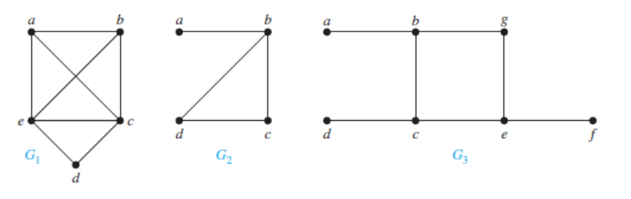
Hamilton Paths and Circuits
EXAMPLE 5(p.577): Which of the simple graphs in Figure 10 have a
Hamilton circuit or, if not, a Hamilton path?
Figure 10 : Three Simple Graphs

Slide 17
Hamilton Paths and Circuits
Solution:
G₁ has a Hamilton circuit: a, b, c, d, e, a.
There is no Hamilton circuit in G₂ (this can be seen by noting that any circuit containing every vertex must contain the edge {a, b} twice),
but G₂ does have a Hamilton path, namely, a, b, c, d.
G₃ has neither a Hamilton circuit nor a Hamilton path, because any path containing all vertices must contain one of the edges {a, b},{e, f }, and {c, d} more than once.

Slide 18
Necessary & Sufficient Criteria for Hamilton Circuits
There are NO known simple necessary and sufficient criteria for the existence of Hamilton circuits. However, many theorems are known that give sufficient conditions for the existence of Hamilton circuits.
Certain properties can be used to show that a graph has no Hamilton circuit. For instance, a graph with a vertex of degree one cannot have a Hamilton circuit, because in a Hamilton circuit, each vertex is incident with two edges in the circuit. Moreover, if a vertex in the graph has degree two, then both edges that are incident with this vertex must be part of any Hamilton circuit.
When a Hamilton circuit is being constructed and this circuit has passed through a vertex, then all remaining edges incident with this vertex, other than the two used in the circuit, can be removed from consideration.
A Hamilton circuit cannot contain a smaller circuit within it.

Slide 19
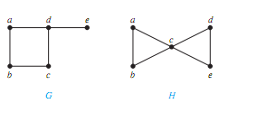
Hamilton Paths and Circuits
EXAMPLE 6 (p.577): Show that neither graph displayed in Figure 11 has a
Hamilton circuit.
Figure 11

Slide 20
Hamilton Paths and Circuits
Solution:
There is no Hamilton circuit in G because G has a vertex of degree one, namely, e.
Now consider H. Because the degrees of the vertices a, b, d, and e are all two, every edge incident with these vertices must be part of any Hamilton circuit. It is now easy to see that no Hamilton circuit can exist in H, for any Hamilton circuit would have to contain four edges incident with c, which is impossible.

Slide 21
Hamilton Paths and Circuits
Extra Question: Is there any Hamilton paths in the graphs of Example 6?
Answer: Yes, both graph contains Hamilton paths.
In graph G ➔ e, d, a, b, c
In graph H ➔ a, b, c, d, e
Question: What are other answers (Hamilton paths)?

Slide 22
Hamilton Paths and Circuits
Theorem 3 (DIRAC’S THEOREM): If G is a simple graph with n vertices with n>=3 such that the degree of every vertex in G is at least n/2, then G has a Hamilton circuit.
Let G = (V, E) be a graph with n vertices in which each vertex has degree at least n/2. Then G has a Hamiltonian cycle.
Theorem 4 (ORE’S THEOREM): if G is a simple graph with n vertices with n>=3 such that
deg(u) + deg(v) >= n for every pair of non-adjacent vertices u and v in G, then G has a Hamilton circuit.

Slide 23
A necessary condition is a condition that must be present for an event to occur.
A sufficient condition is a condition or set of conditions that will produce the event.
When sufficient condition is satisfied the event will happen in the graph. But every time when the event happens it is not necessary the the sufficient condition will be full filled.
In necessary condition: every time when the event happens the necessary condition will be full filled.

Slide 24
Hamilton Paths and Circuits
Both Ore’s Theorem and Dirac’s Theorem provide sufficient conditions for a connected simple graph to have a Hamilton circuit. However, these theorems do not provide necessary conditions for the existence of a Hamilton circuit.
  For example, the graph C₅ has a Hamilton circuit but does not satisfy the hypotheses of either Ore’s Theorem or Dirac’s Theorem

Slide 25
Exercise 37 (p.583)
Does the following graph have a Hamilton path? If so, find such a path. If it does not, give an argument to show why no such path exists.
a d
c f
b e

Slide 26
Exercise 37 (p.645)
Solution:
This graph has the Hamilton path a, b, c, f, d, e.
This simple path hits each vertex once.
a d
c f
b e
Question: Does the above graph have Hamilton Circuit? Explain.
26

Slide 27
Euler vs. Hamilton Paths & Circuits
On the surface, there is a one-word difference between Euler paths/circuits and Hamilton paths/circuits: The former covers all edges; the latter covers all vertices.
Euler path/circuit == > main concern Edge
  ALL the EDGES must be visited exactly ONCE
Hamilton path/circuit ==> main concern Vertex
  ALL the VERTICES must be visited exactly ONCE
27

Slide 28
Euler vs. Hamilton Paths & Circuits
Note: If a graph has a Hamilton circuit, then it automatically has a Hamilton path–the Hamilton circuit can always be truncated into a Hamilton path by dropping the last vertex of the circuit. (For example, the Hamilton circuit A, F, B, C, G, D, E, A can be truncated into the Hamilton path A, F, B, C, G, D, E.)
==> See next slide
Contrast this with the mutually exclusive relationship between Euler circuits and Euler paths: If a graph has an Euler circuit it cannot have an Euler path and vice versa.
28

Slide 29
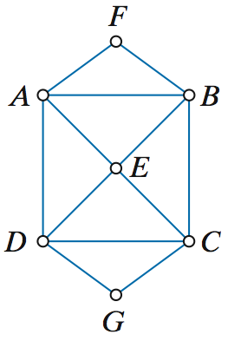
Example
The figure shows a graph that (1) has Euler circuits (the vertices are all even-degree) and (2) has Hamilton circuits.
One such Hamilton circuit is
A, F, B, C, G, D, E, A – there are plenty more.
Can you identify an Euler circuit in this graph?
29

Slide 30
Practice @ Home
Relevant Odd-Numbered Exercises
19, 21, 31, 35, 37, 39, 43, 47

Slide 31
Books
Rosen, K. H., & Krithivasan, K. (2012). Discrete mathematics and its applications: with combinatorics and graph theory. Tata McGraw-Hill Education. (7th Edition)
Liu, C. L. (1986). Elements of discrete mathematics. Tata McGraw-Hill Education.

Slide 32
References
Discrete Mathematics, Richard Johnsonbaugh, Pearson education, Inc.
Discrete Mathematical Structures, Bernard Kolman, Robert C. Busby, Sharon Ross, Prentice-Hall, Inc.
SCHAUM’S outlines Discrete Mathematics(2nd edition), by Seymour Lipschutz, Marc Lipson
Online learning platform
https://courses.lumenlearning.com/math4liberalarts/chapter/introduction-euler-paths/
University of Hawaii materials
http://courses.ics.hawaii.edu/ReviewICS241/morea/graphs/Graphs5-QA.pdf
Online learning
https://www.geeksforgeeks.org/mathematics-euler-hamiltonian-paths/

